Slide 1


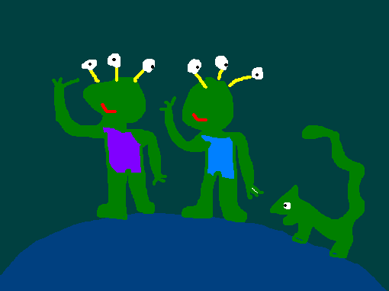
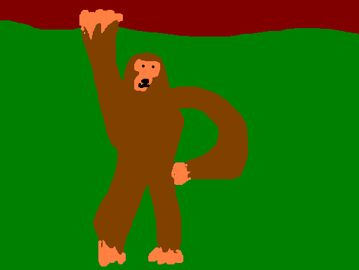

The earth was bombarded by meteors
I saw a TV show which said life arrived on a meteor from space and gradually evolved into humans.
2. One of the meteors had bacteria in it.
4. Then he made Animals.
3. It had come from an alien planet.
4. The bacteria evolved and made us

Slide 2

When you’re young you just believe what you’re told – you’ll believe anything!

Slide 3


So why do humans
exist?

Slide 4

Either we evolved or God made us. You take your pick basically.

Slide 5
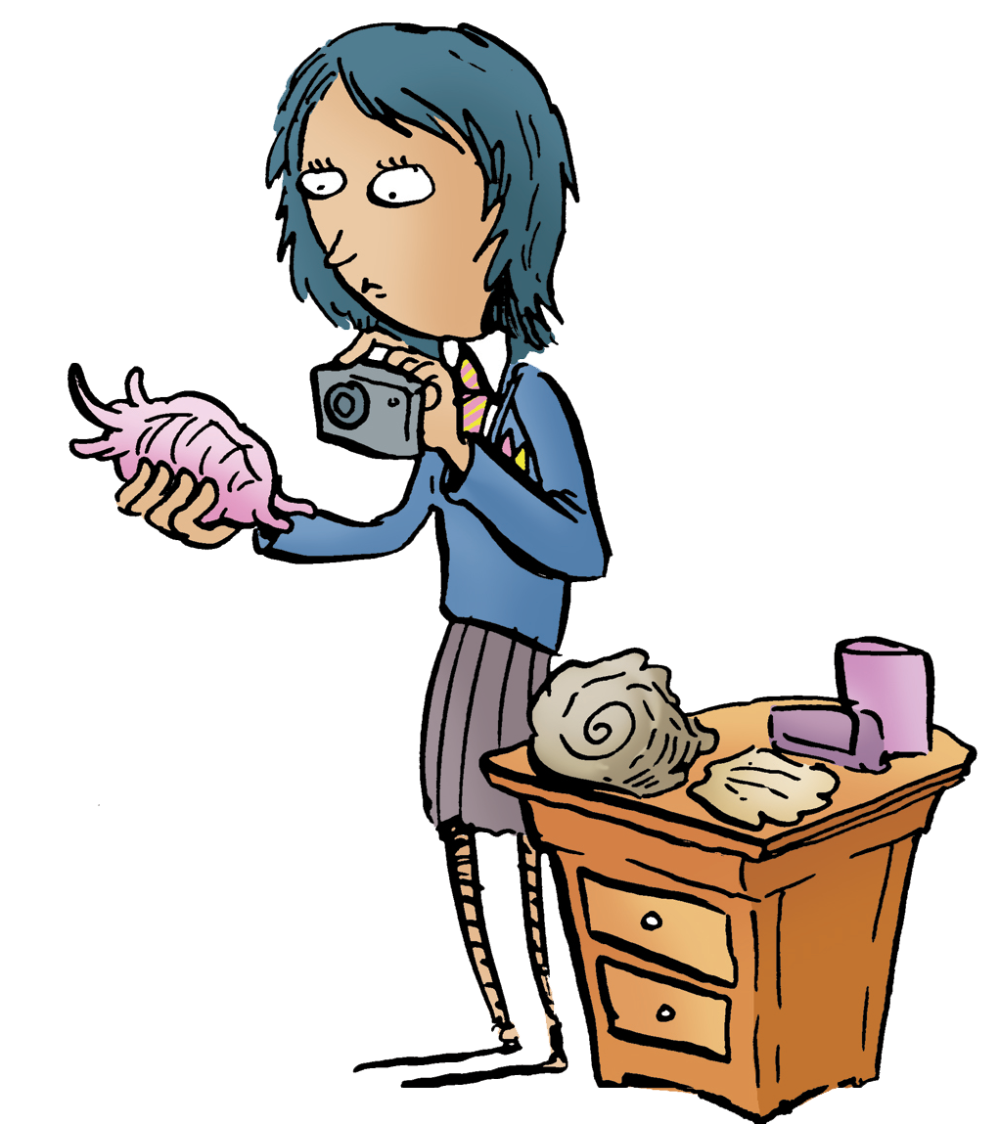
Can we believe that God created life but ALSO that it evolved?

Slide 6

Here’s what one scientist said
I like to imagine that the task of scientists to study the ‘texts’ of God’s universe and find out how they’re written. Science is the way we find out how God has written the book of creation and how he continues to sustain all that exists. To press the analogy a bit further, in my mind, this is a book that is still being written.
Dr Denis Alexander is a biologist and also a Christian.

Slide 7
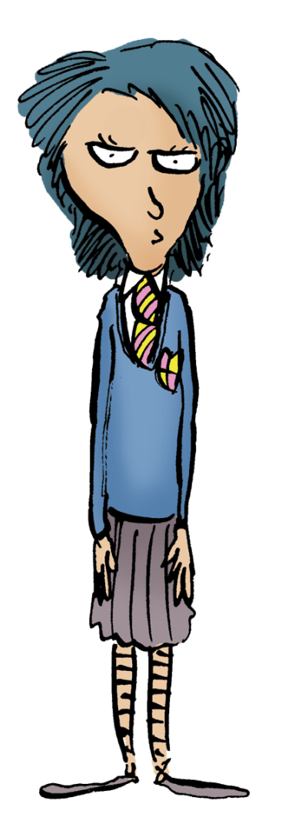
What do you think?
Why do humans come
to be here?

